Slide 1
















Technical 3
Christian Dataro

Slide 2
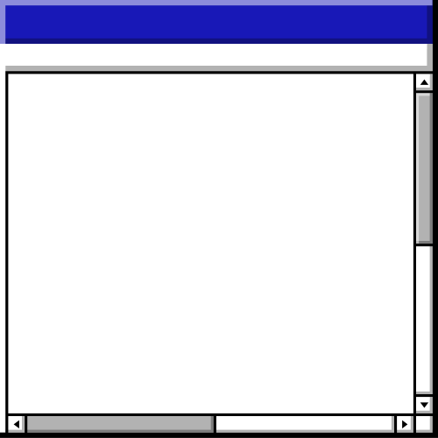

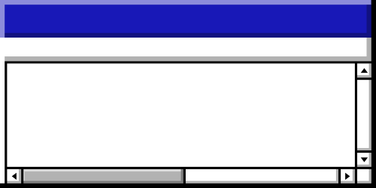
Agenda • Agenda • Agenda • Agenda • Agenda • Agenda • Agenda • Agenda • Agenda • Agenda • Agenda • Agenda • Agenda • Agenda
Topics Covered
heartattack.xlsx
StudentPerforma...
Agenda

Slide 3















Section Header • Section Header • Section Header • Section Header • Section Header • Section Header • Section Header • Section Header
Insights for Heart Attack dataset
Back to Agenda Page
Section Header • Section Header • Section Header • Section Header • Section Header • Section Header • Section Header • Section Header

Slide 4
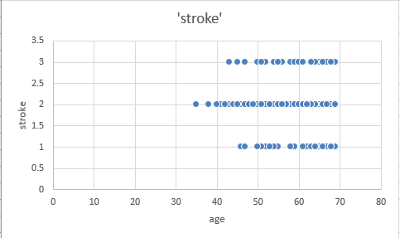
Stroke
The data shows strongly how the stroke affects people from the age 40 and above.
Back to Agenda Page

Slide 5
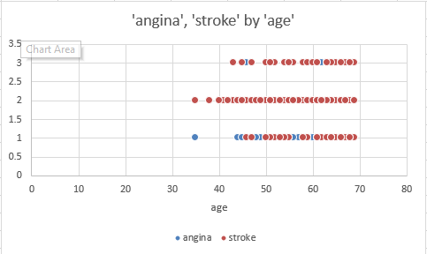
Stroke and Angine by age
The data shows strongly how the stroke affects people from the age 40 and above.
Back to Agenda Page

Slide 6
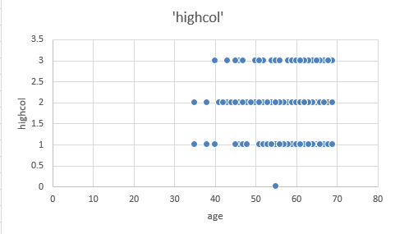
high colesterol by age
The data shows strongly how the stroke affects people from the age 40 and above.
Back to Agenda Page

Slide 7
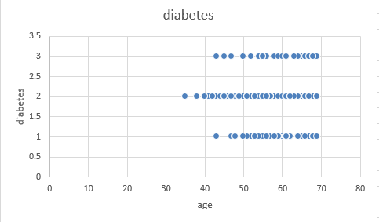
Diabetes by age
The data shows strongly how the stroke affects people from the age 40 and above.
Back to Agenda Page

Slide 8
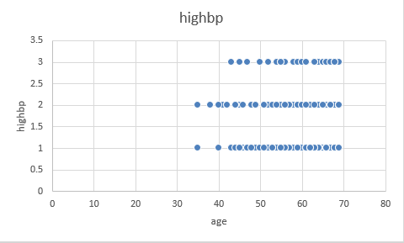
high bp by age
The data shows strongly how the stroke affects people from the age 40 and above.
Back to Agenda Page

Slide 9
Section Header • Section Header • Section Header • Section Header • Section Header • Section Header • Section Header • Section Header
Insights for Student Performance dataset
Back to Agenda Page
Section Header • Section Header • Section Header • Section Header • Section Header • Section Header • Section Header • Section Header

Slide 10
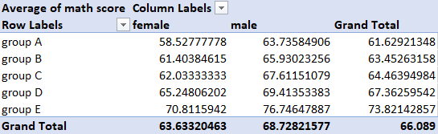
Average Math Score based on gender and groups
Female
Male
0
25
50
75
The lower percentage of the populated are Females which is 63.63%. On the other hand, Males populated 68.72%
Back to Agenda Page

Slide 11
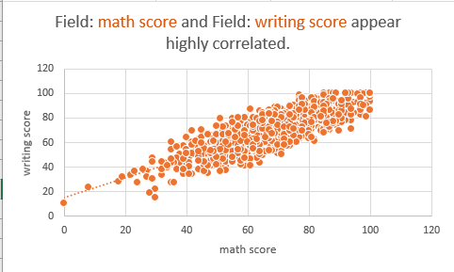
Correlation between math score and writing score
The data shows that writing scores are directly proportional to math scores.
Back to Agenda Page

Slide 12
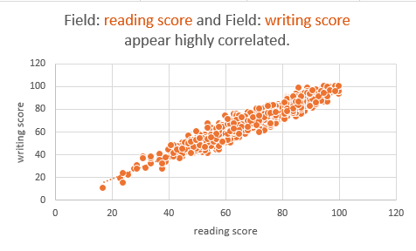
Correlation between reading score and writing score
The data shows that writing scores are directly proportional to reading scores.
Back to Agenda Page

Slide 13
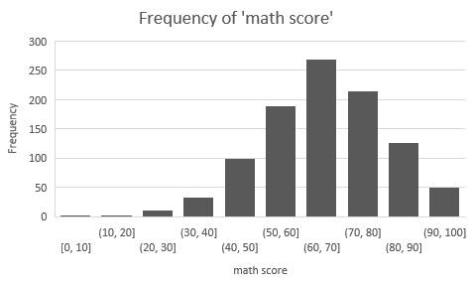
Frequencies of math score
The data shows the number of times that the number appeared.
Back to Agenda Page

Slide 14
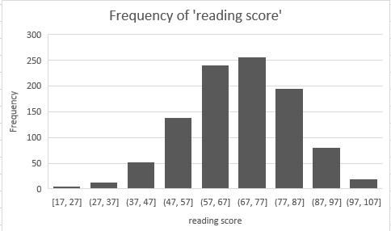
Frequencies of reading score
The data shows the number of times that the number appeared.
Back to Agenda Page

Slide 15
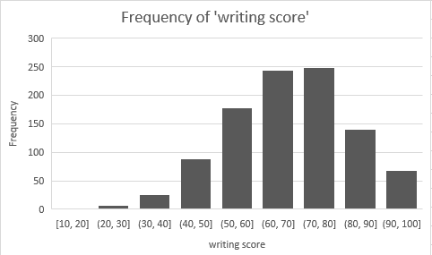
Frequencies of writing score
The data shows the number of times that the number appeared.
Back to Agenda Page

Slide 16





Write your topic or idea
Add a main point
Add a main point
Add a main point
Briefly elaborate on what you want to discuss.
Briefly elaborate on
what you want to discuss.
Briefly elaborate on
what you want to discuss.
Back to Agenda Page

Slide 17

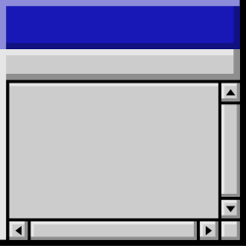
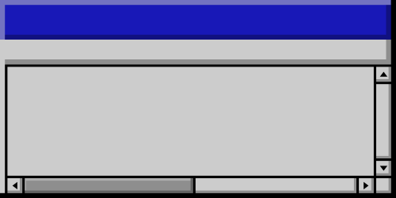
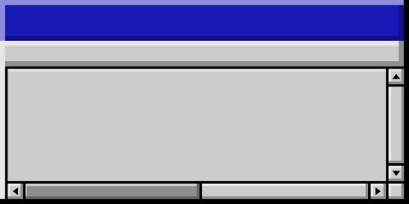

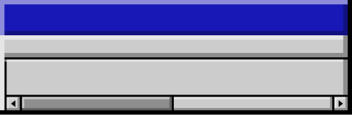
Thank you!

